Slide 1
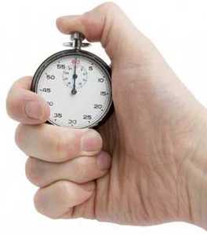
Timers
JMeter thread sends requests without pausing between each sampler by default ,which may lead to sending multiple requests to server in short span of time.
Timers allow Jmeter to delay between each request
Prepared By : M.Poojitha

Slide 2
Timers
Types of Timers
Constant Timer
Gaussian Random Timer
Uniform Random Timer
Synchronizing Timer

Slide 3
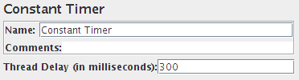
Timers
Constant Timer
Constant Timer is used to delay every user request for the same amount of time.
If you want to have each thread pause for the same amount of time between requests, use constant timer.

Slide 4
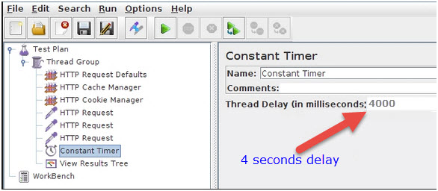
Timers
Constant Timer

Slide 5
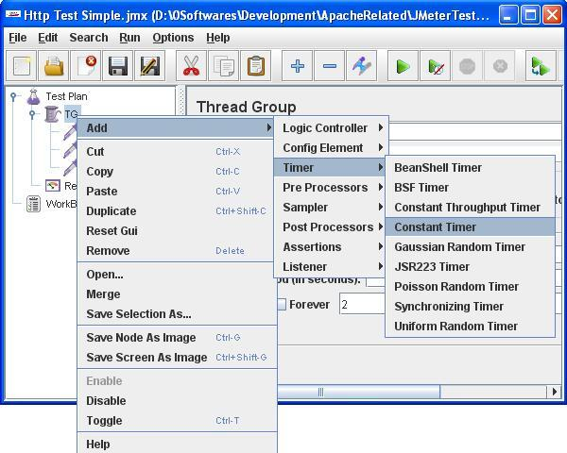
Timers
Adding Constant Timer

Slide 6
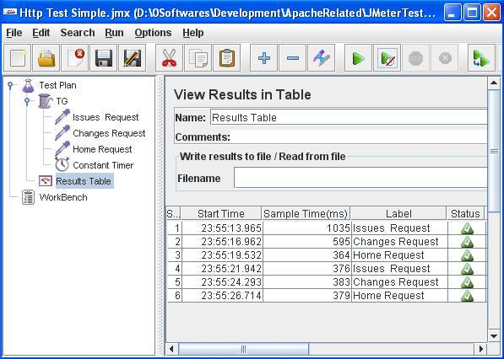
Timers
Constant Timer Results

Slide 7
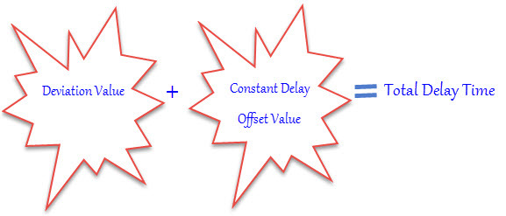
Timers
Gaussian Random Timer
Gaussian Random timer pauses each thread request for a random amount of time intervals occurring near a particular value.
Gaussian Random means with most of the time intervals arising near a specific value
The total delay is the sum of the Gaussian distributed value times the deviation value you specify and offset value.

Slide 8
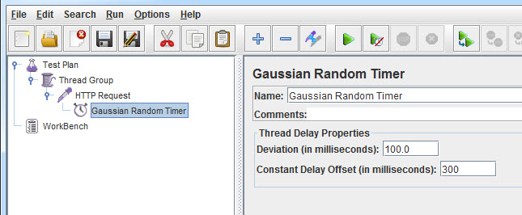
Timers
Gaussian Random Timer

Slide 9
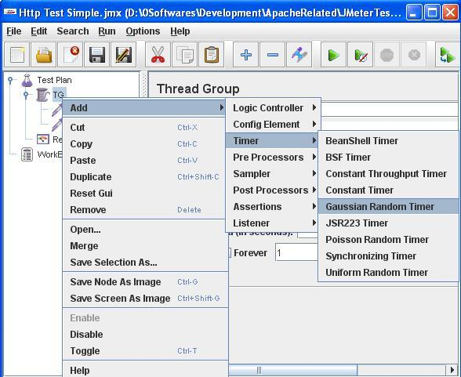
Timers
Adding Gaussian Random Timer

Slide 10
Timers
Adding Gaussian Random Timer

Slide 11
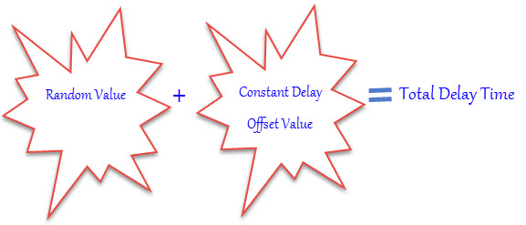
Timers
Uniform Random Timer
Uniform Random timer pauses each thread request for a random amount of time , with each time interval having the same probability of occurring.
Uniform Random Timer delays each user requests for a random amount of time.
The Total delay is Sum of random value and offset value.

Slide 12
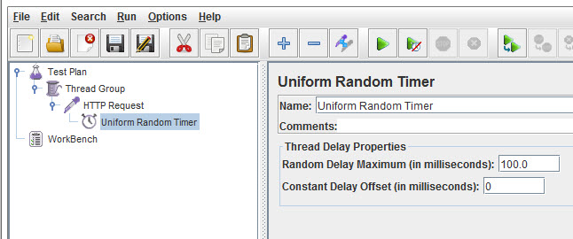
Timers
Uniform Random Timer

Slide 13
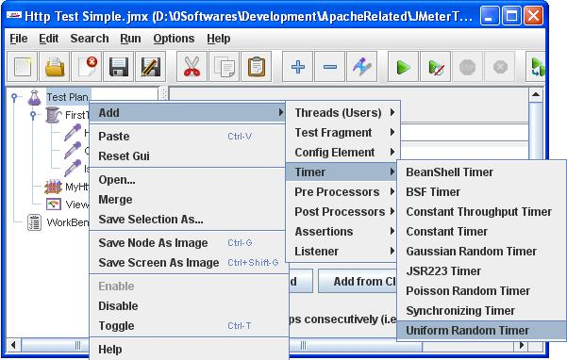
Timers
Adding Uniform Random Timer

Slide 14
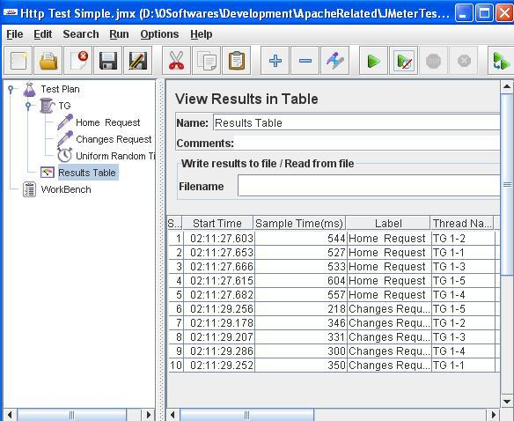
Timers
Uniform Random Timer Results

Slide 15
Timers
Synchronizing Timer
Synchronizing Timer is used to synchronize requests of various threads.
Synchronizing Timer will increase delays between requests. So that, all threads fire at the same time there for regenerating heavy load bursts on the application.
It is same like Rendezvous Point in Load Runner and create big load at various places in JMeter plan.

Slide 16
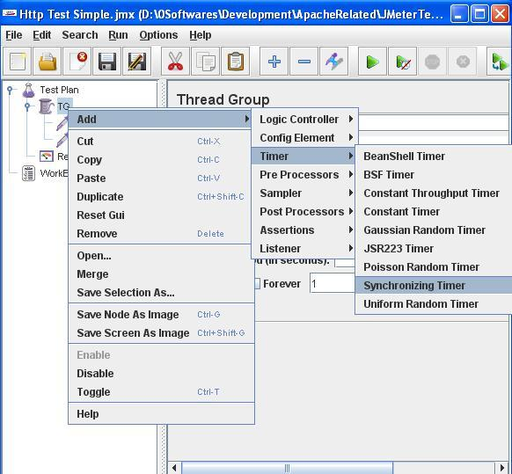
Timers
Adding Synchronizing Timer

Slide 17
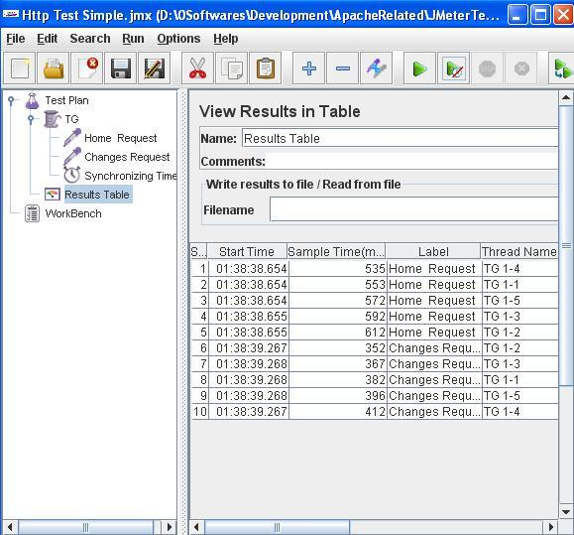
Timers
Synchronizing Timer Results

Slide 18

Thank You

